Slide 1
NATURAL CHOICES FOR SUSTAINABLE FLEET OPERATIONS AND BUDGETS
Ron Flowers, United Soybean Board Consultant
September 11, 2019

Slide 2
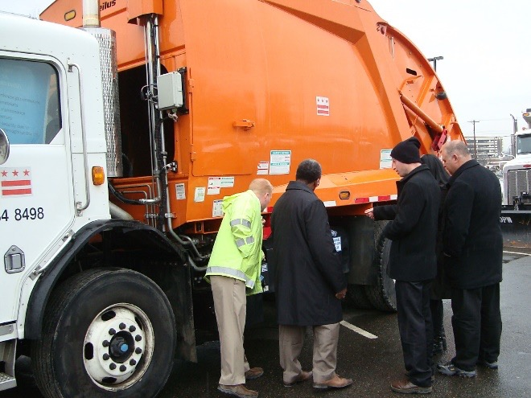
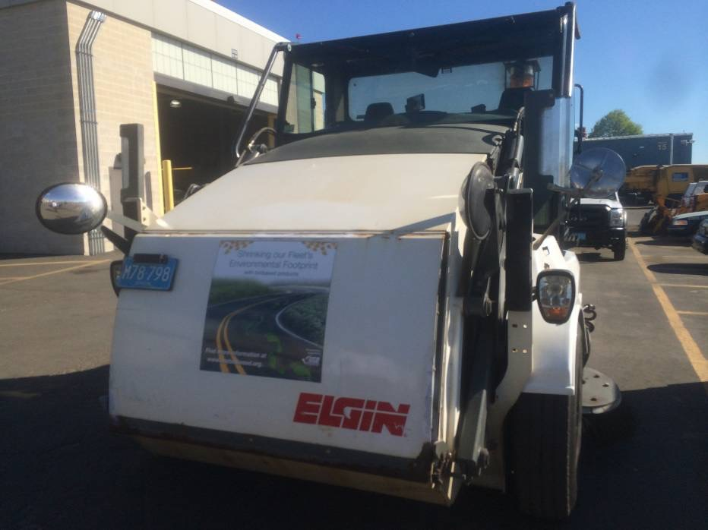
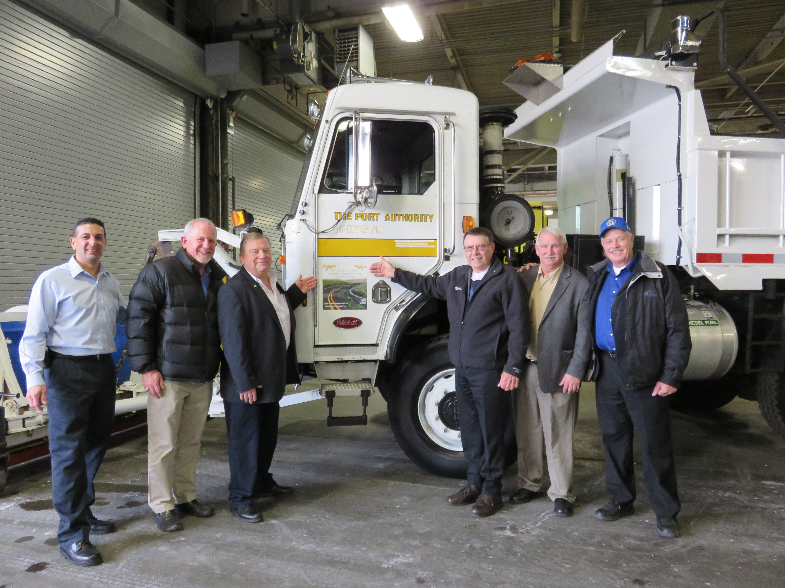
Washington, DC
Logan Airport
NY/NJ Port Authority
Notes:
Many parks, communities and organizations are Greening their equipment fleet to both reduce their environmental footprint and as a way to promote their efforts to gain support. DC “greened” several pieces of equipment in demonstration projects. Others such as Logan Airport and the NY/NJ Port Authority have greened high visibility vehicles as a way to show the public their commitment to reducing their environmental footprint.

Slide 3
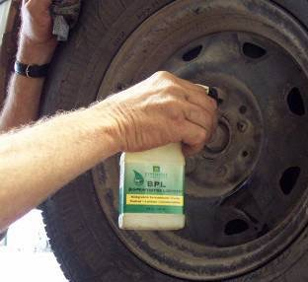
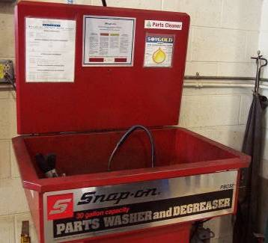
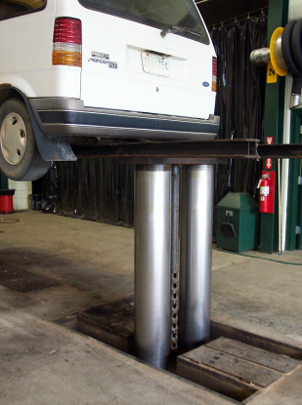
SHOP OPERATIONS
Penetrates between threads
High flash point
Low evaporation
Residual lubrication
Water displacing
Performance equal to petroleum solvents
Low VOC and health hazard
300 degree flash point
Equal performance as petroleum
Reduced impact in event of leak
Notes:
Another opportunity to significantly improve the health and safety of the personnel working in shop areas is with Biobased alternatives to the products typically used for vehicle and equipment maintenance. Many perform better than the petroleum based products. One example here is Biobased Parts Washer fluid which is non flammable, with a flash point of over 300 degrees.

Slide 4
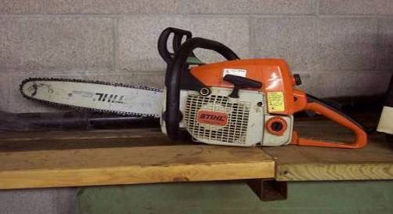
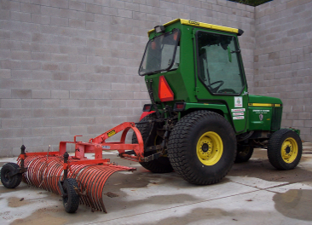
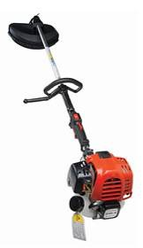
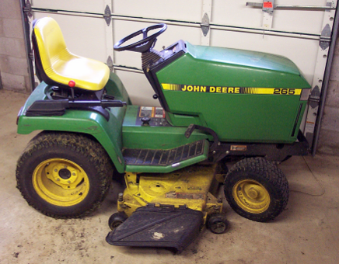
GROUNDS MAINTENANCE
Notes:
In Grounds Maintenance - “Green-Up” taking care of your green areas The use of bio based 2-cycle engine oils, bar an chain oil, trans-hydrostatic fluids all contribute to lessening the environmental footprint of grounds maintenance activities. Many Class A grounds keeping operations prefer bio based fluids in their equipment because it won’t kill the grass in event of a leak or spill. Bar and chain oil is a direct loss product. Every drop of oil goes directly from the bar into the environment. Bio base bar oil is readily biodegradable resulting in a smaller footprint in chainsaw operations.

Slide 6
THANK YOU!
RON FLOWERS
United Soybean Board Consultant
ronald.flowers@rksolutions.org
(202) 640-0423

